Slide 1

Project ontwerpen: Soldering Station
By Nino Bleus

Slide 2


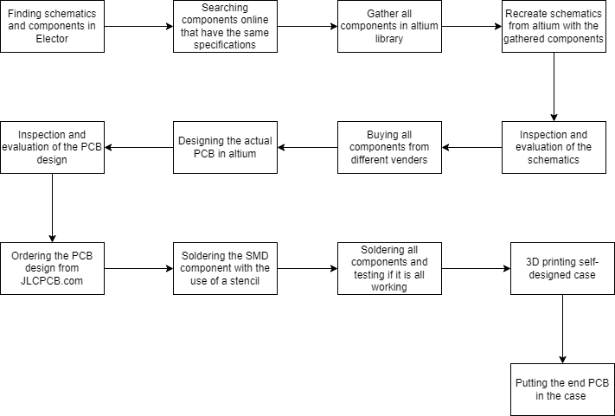
Overview
Je kent de formules van coulomb kracht, spanning, stroom
Finding the components
Schematics designing
PCB designing
Soldering the components
Case designing

Slide 3

Finding the components

Slide 4
Finding the components
Components list from Elektor
Finding the same components on Mousser.com
Ordering the components in a group
Importing components in Altium
Notes:
The right components are needed to start this project, luckily there is a list provided by Elektor with all necessary information. It includes all the components and explanations about parts of the circuit. This made it a lot easier to buy the right ones. Mouser.com has a great tool that lets u find components with similar specifications as the one that’s used in the Elektor. This part of the process took roughly 2 days. After finding all the needed parts u can go and add them into the library on Altium.

Slide 5
Schematics designing

Slide 6
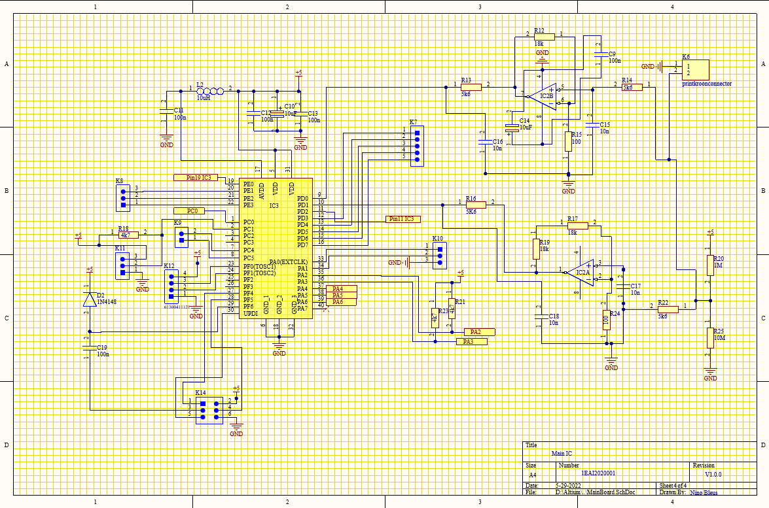
Schematic design
Recreating Elektor schematics
Making no mistakes
Notes:
The schematics could be designed after filling up the library. This part of the process took roughly 1 day. These schematics can be found in the Elektor as well, so it simply was copy and pasting it with the components from the self-made library. The figure below shows the main circuit of the PCB. It contains the ATMEGA4809-PF chip. This can be considered as the brains of the whole device.

Slide 7
PCB designing

Slide 8
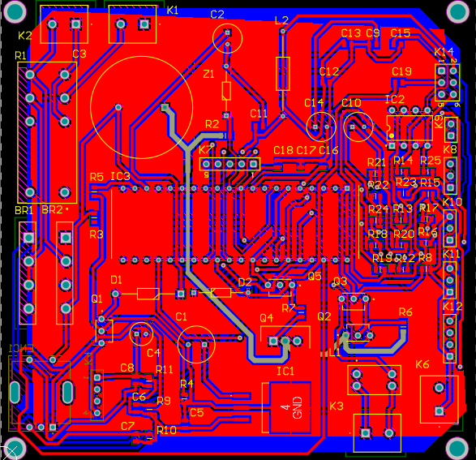
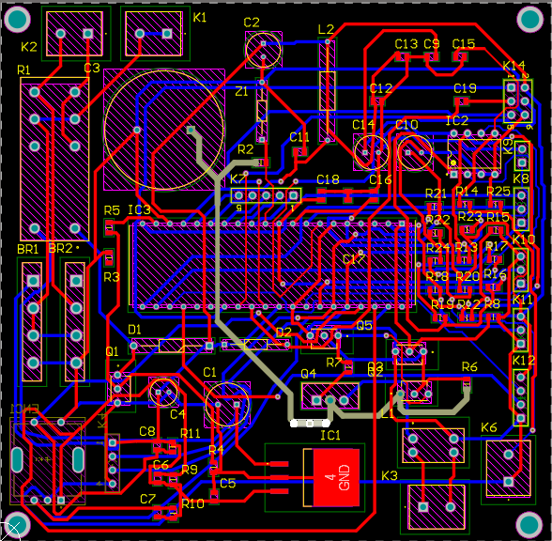
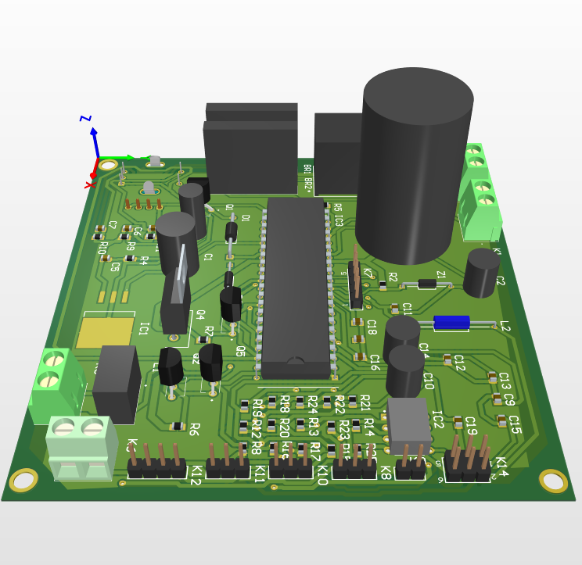
PCB designing
Placing components
Auto-routing
Checking auto-route
Make tracers wider
Adding polygons
Ordering PCB on JLCPCB.com (in group)
Notes:
The figure below is a 3D model of the final PCB design . PCB designing start with placing all the components in a self determined shape (in this case a 10 cm by 10 cm square). When the designer is satisfied with the place of the components, the traces can be placed. This is done by a tool within Altium called Auto-rooting. It automatically builds a traces with a standard width. The only thing that needs to be done after auto-rooting is fine tuning. Some traces need to be wider then others because there is more power going true them. The last step in PCB designing is adding copper polygons to the PCB . Polygons are used as a ground for the circuit and also to provide electro-magnetic shielding. After all these steps it is time to order the PCB on JLCPCB.com.

Slide 9
Soldering the components

Slide 10
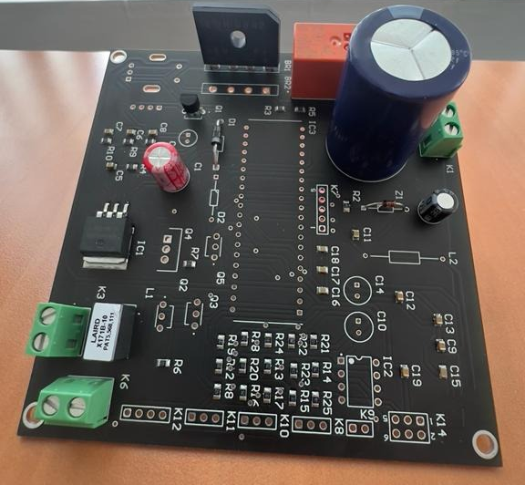
Soldering the components
Start with SMD
THT components
Notes:
When the PCB is delivered, the soldering can start. First solder the SMD components to the PCB with help of the stencil. This is done by fitting the stencil to the PCB and going over it with a thin layer of solder paste. When the paste is applied, the SMD components can be placed. When this is done, simply lay it in a PCB oven with a special temperature curve for a couple of minutes. After that start soldering the through hole components by hand.

Slide 11
Case designing

Slide 12
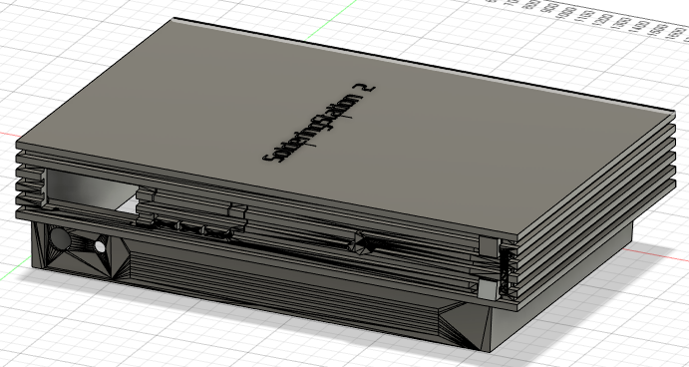
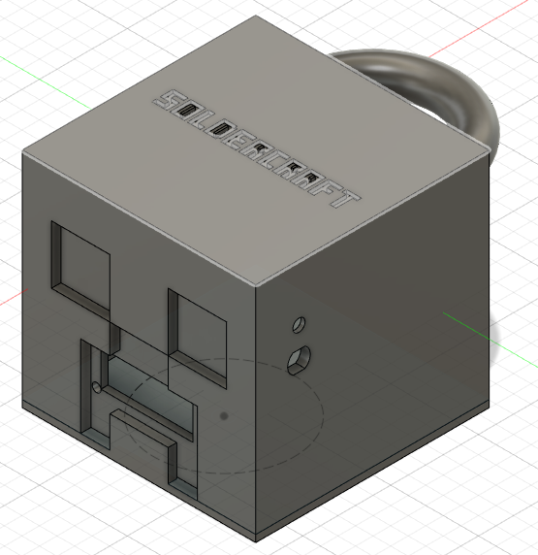
Case designing
Trial and error first design
Rethink design
Reason for design
Notes:
The thought process behind the designing of the case was hard. At first there was the “SolderingStation 2” . It seemed fun in the beginning but was to hard to fit everything in. That’s why the “SolderCraft” case is designed. The first case was inspired by Tim Boghe. He made a case in the shape of his first gaming console. This provided the inspiration for the PlayStation 2 design. It’s a shame that it wasn’t realisable. Going back to the drawing board for idea’s, Minecraft came to light. It was the first game that was bought and played by the author.

Slide 13
Questions?

